Slide 1
Human computer interaction
Covid-19 information application
Talha Sarfaraz 61933
Mohsin Ali 62008

Slide 2
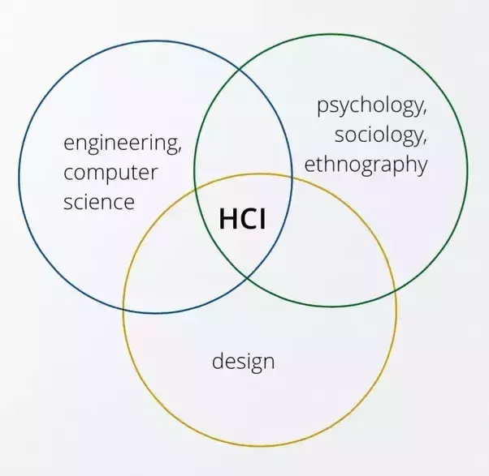
The Goals of HCI
The goals of HCI are to produce usable and safe systems, as well as functional systems. In order o produce computer systems with good usability, developers must attempt to:
understand the factors that determine how people use technology
develop tools and techniques to enable building suitable systems
achieve efficient, effective, and safe interaction
put people first

Slide 3
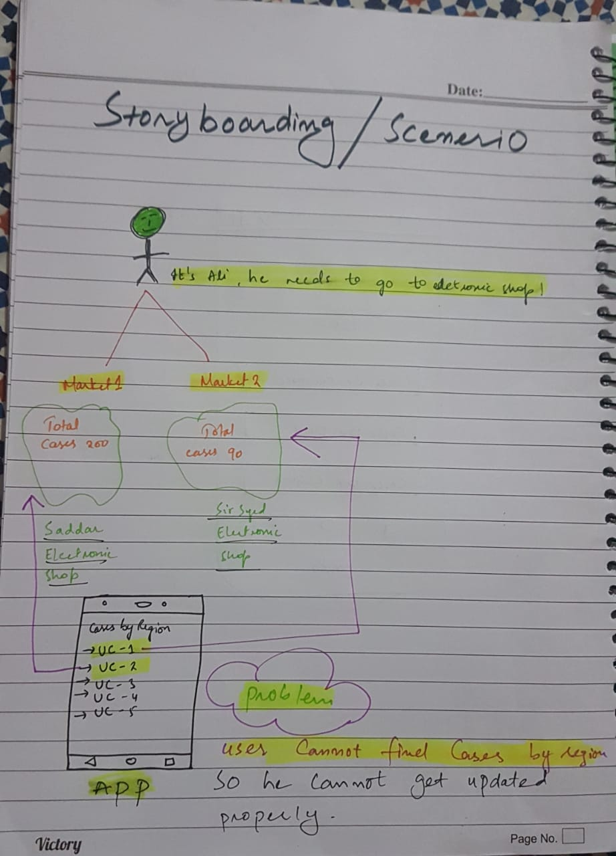
Design Process story board
Problem in this design is that user cannot updated properly

Slide 4
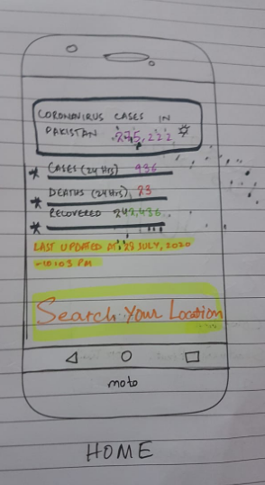
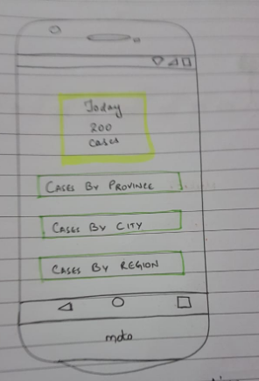
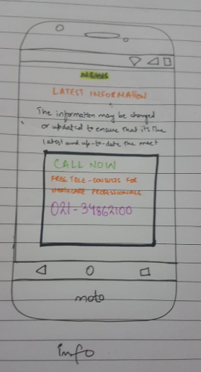
Design process prototypes

Slide 5
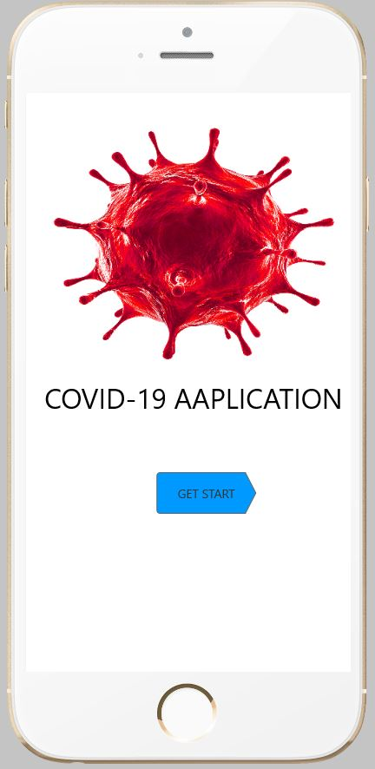
Design process prototypes process 2

Slide 6
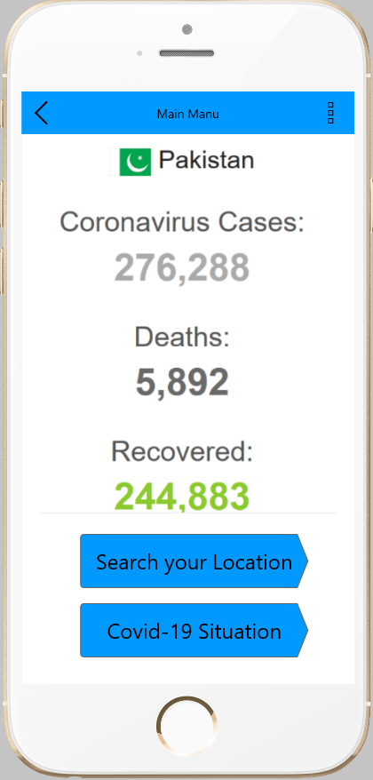
Design process prototypes process 2

Slide 7
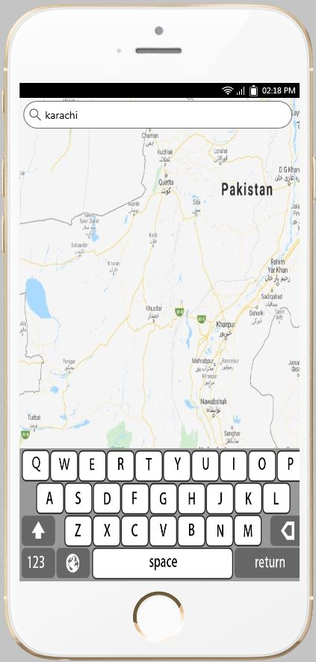
Design process prototypes process 2

Slide 8
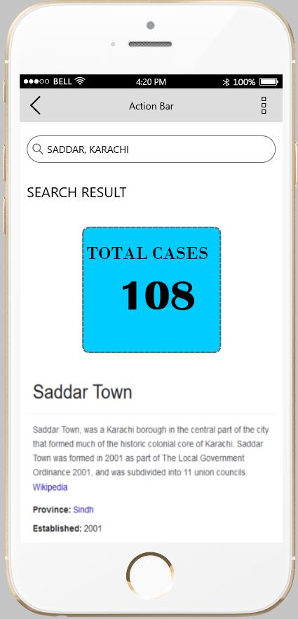
Design process prototypes process 2

Slide 9
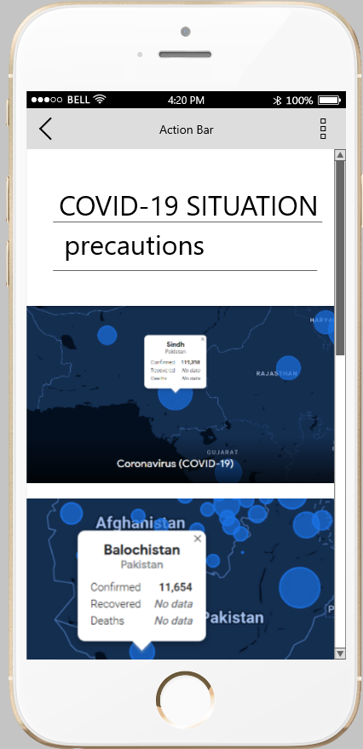
Design process prototypes process 2

Slide 10
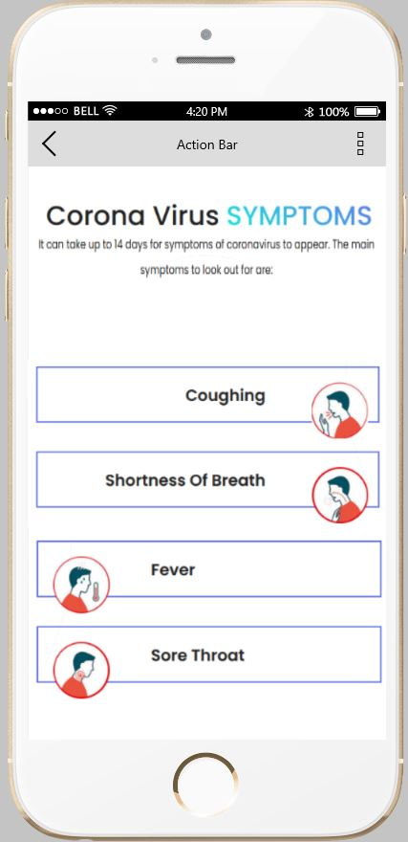
Design process prototypes process 2

Slide 11
conclusion
This is our final UI for covid-19 app
Thing which we change this mockup is that we google map primarly pickup the country then if user want to check active cases in his/her own area map pick it automatically
As per users experience area vise UI improve that cases show on live map and information show on tooltip on area

